Slide 1
Assessment Type 1 Task 2 Data Visualisation AWS Glue DataBrew - (Individual)
SACE ID - 671489F

Slide 2
Brief
Complete the following labs:
● Profiling and Data Quality
● Transforming Data
● Cloud foundations
● Cloud-based platforms & data representation
Product: 5-minute (Maximum) Multimodal Presentation worth 12.5%.
Evidence via:
● Podcast / Vlog / Video / Presentation / Digital Whiteboarding

Slide 3
Pre-Planning
Before we'd started the practical work, we had an exercise in which we had to identify and later discuss what household items do we know or use which is considered an internet of things (IOT).
An IOT is described as an electrical device which is connected in some capacity to a source of data developed with the intention of further integration with internet and accessibility. These are such as satellites, cellular towers, internet receptors etc; electronics which interact/disperse/contain some amount of wifi, and with that, data.

Slide 5
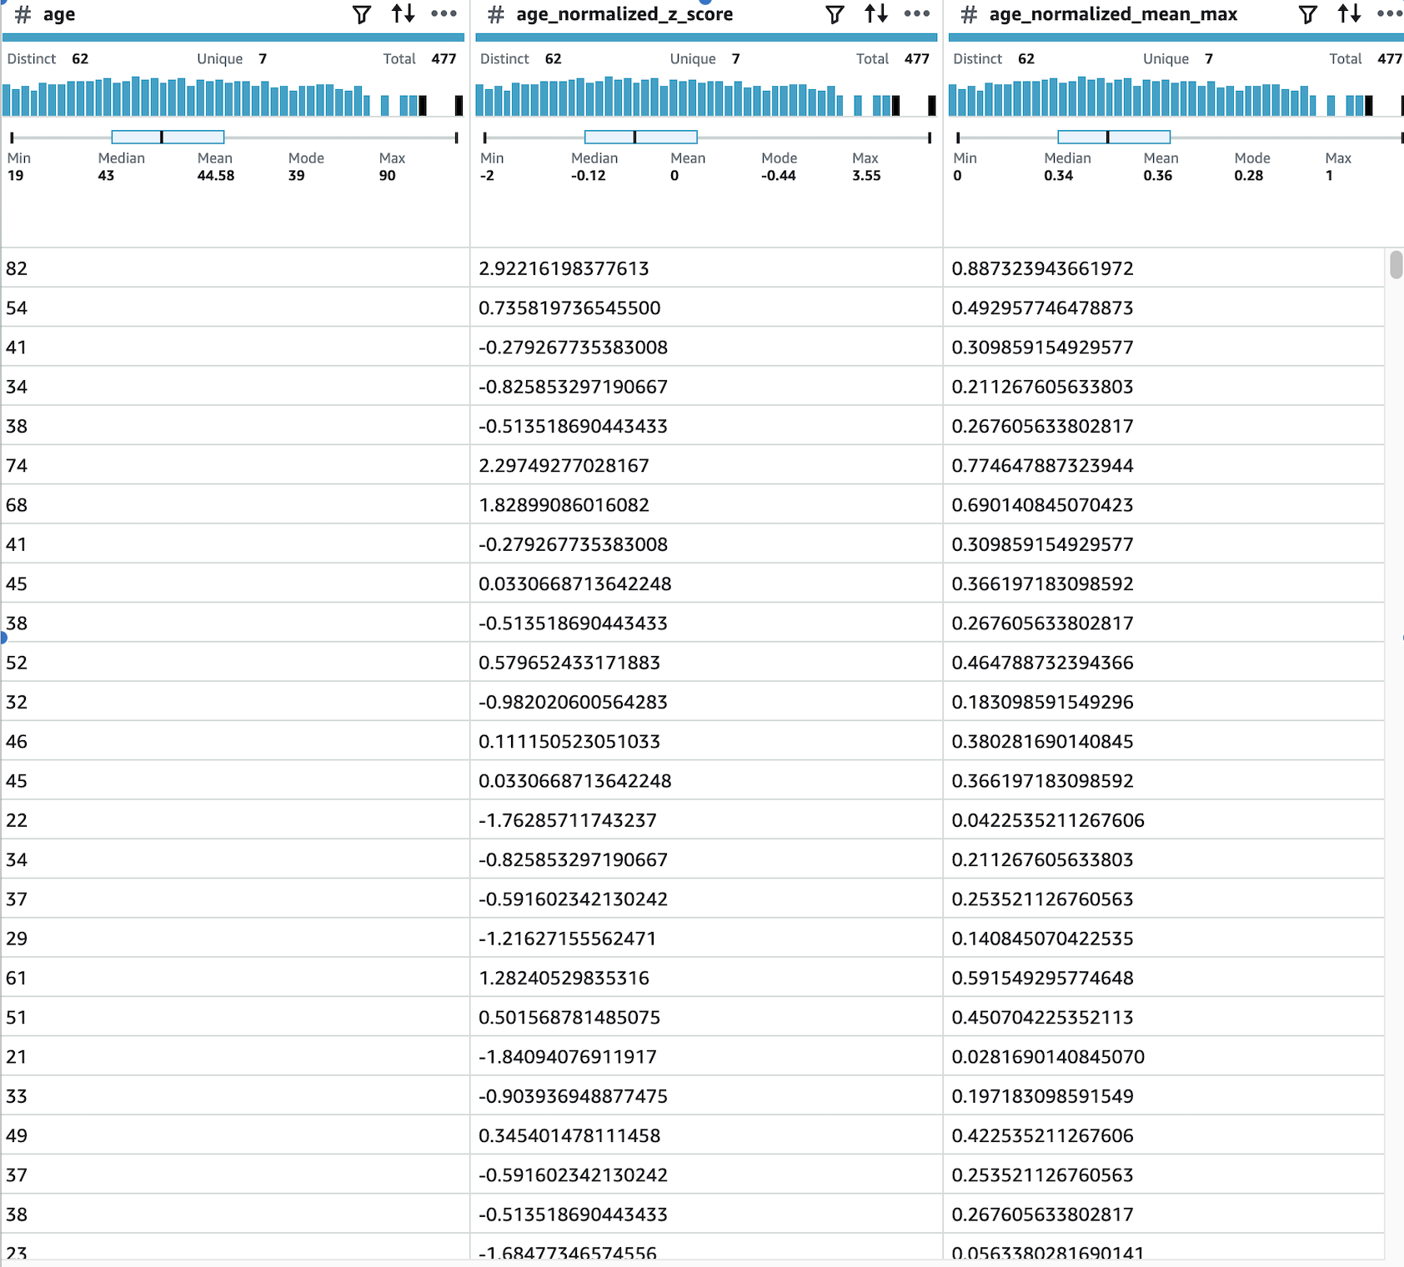
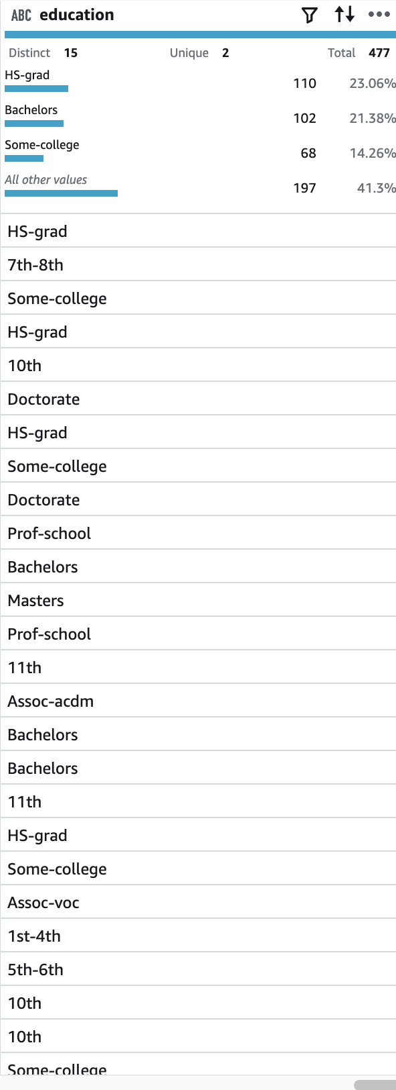
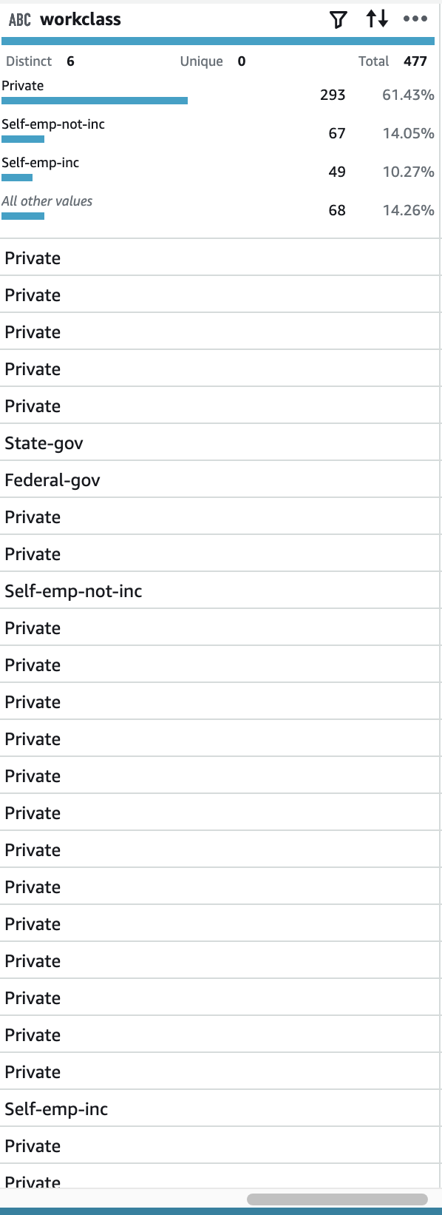
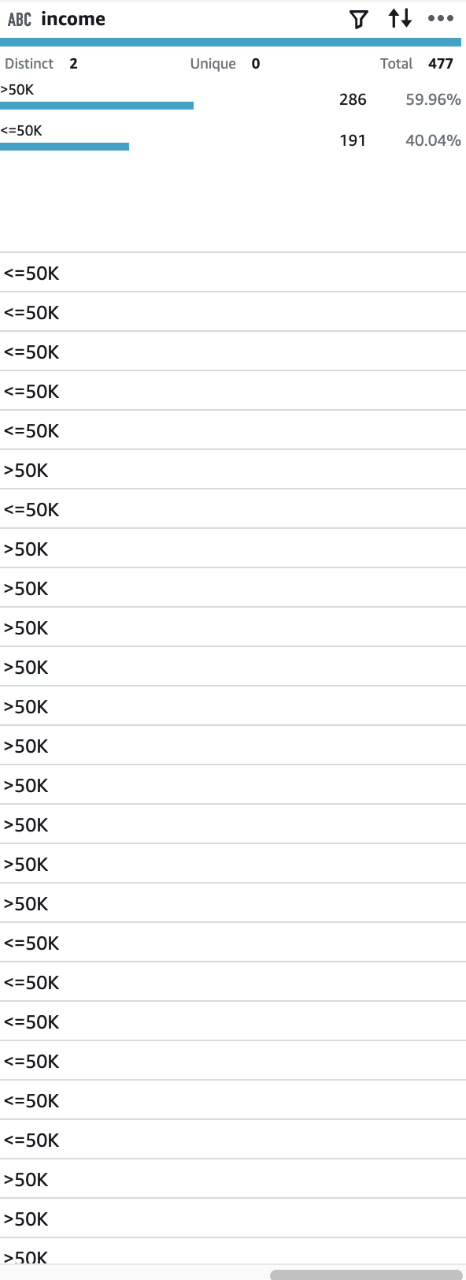
Conclusion
The entirety of what we were required to complete was completed and modified to source relevant information and data to me in preparation for task 3.
This is the final product that the program led to for me, a list compiled to retain and modify (public accessible) data regarding peoples age, education level and occupation level in the work force in relation to finance.

Slide 6
https://catalog.us-east-1.prod.workshops.aws/event/dashboard/en-US/workshop/80-data-security-and-sharing

